Slide 1

Game Design and Development
Factor.io
Prototype 1

Slide 2
Agenda
What did we implement?
Balancing
Technical background
What else do we want to implement?
Live-Demo-Video

Slide 3

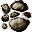

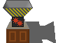
Gravel and Sand
Source: Factorio

Slide 4

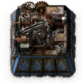




Gold
Source: Factorio

Slide 5
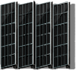

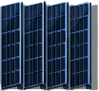
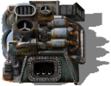
Glas and better Solarpanels
Source: Factorio
Source: Factorio

Slide 6



Salt and a new Poisoncapsule

Slide 7
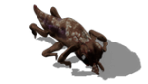

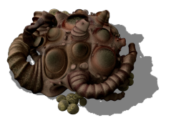




Meat, Mushrooms, Seeds and Apples
Source: Factorio
Source: Factorio
Source: Factorio

Slide 8
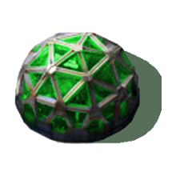






Greenhouse and Plants

Slide 9


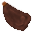


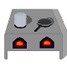








Food

Slide 10
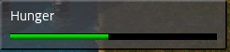
Hunger

Slide 11
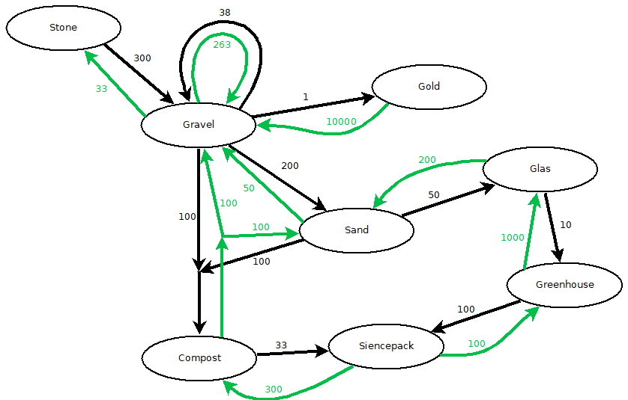
Balancing

Slide 12
HUNGER_DECREASE_DEPEND_CRAFT = 0.2
HUNGER_DECREASE_DEPEND_TILE = 0.1
HUNGER_DECREASE_DEPEND_ITEM = 0.2
HUNGER_DECREASE_DEPEND_BUILD = 0.2
HUNGER_DECREASE_DEPEND_REMOVE = 0.2
DEFAULT_ACQUIRE_RAW_FISH = 5
ADD_HUNGER_EATING_FISH = 10.0
ADD_HEALTH_EATING_FISH = 0.0
ADD_HUNGER_EATING_RAW_MEAT = 2.0
ADD_HEALTH_EATING_RAW_MEAT = -150.0
ADD_HUNGER_EATING_COOKED_MEAT = 15.0
ADD_HEALTH_EATING_COOKED_MEAT = 0.0
ADD_HUNGER_EATING_MUSHROOM = 2.0
ADD_HEALTH_EATING_MUSHROOM = 0.0

Slide 13
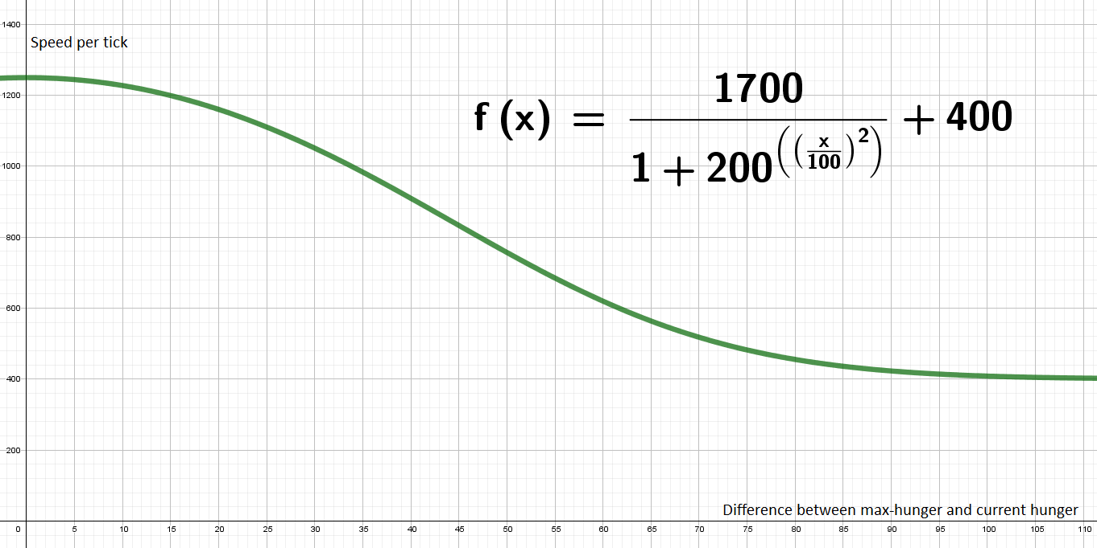
Technical background

Slide 14
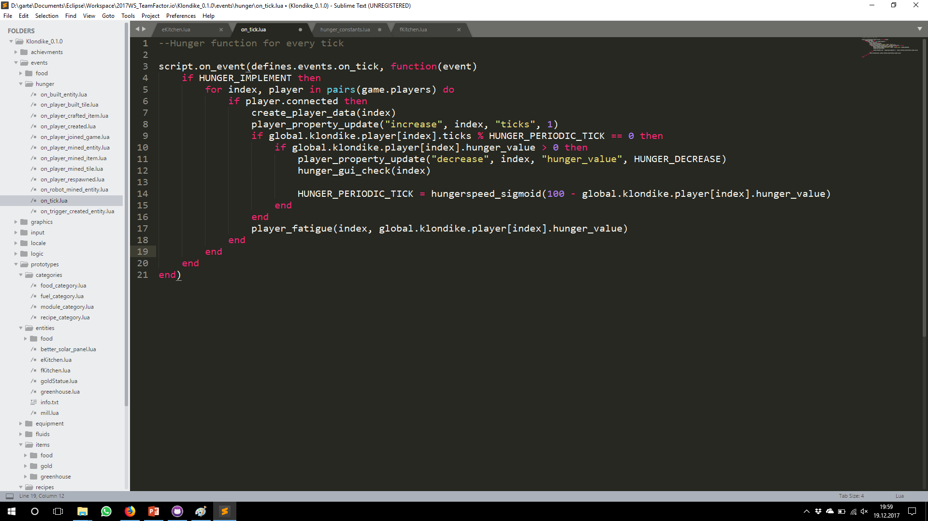
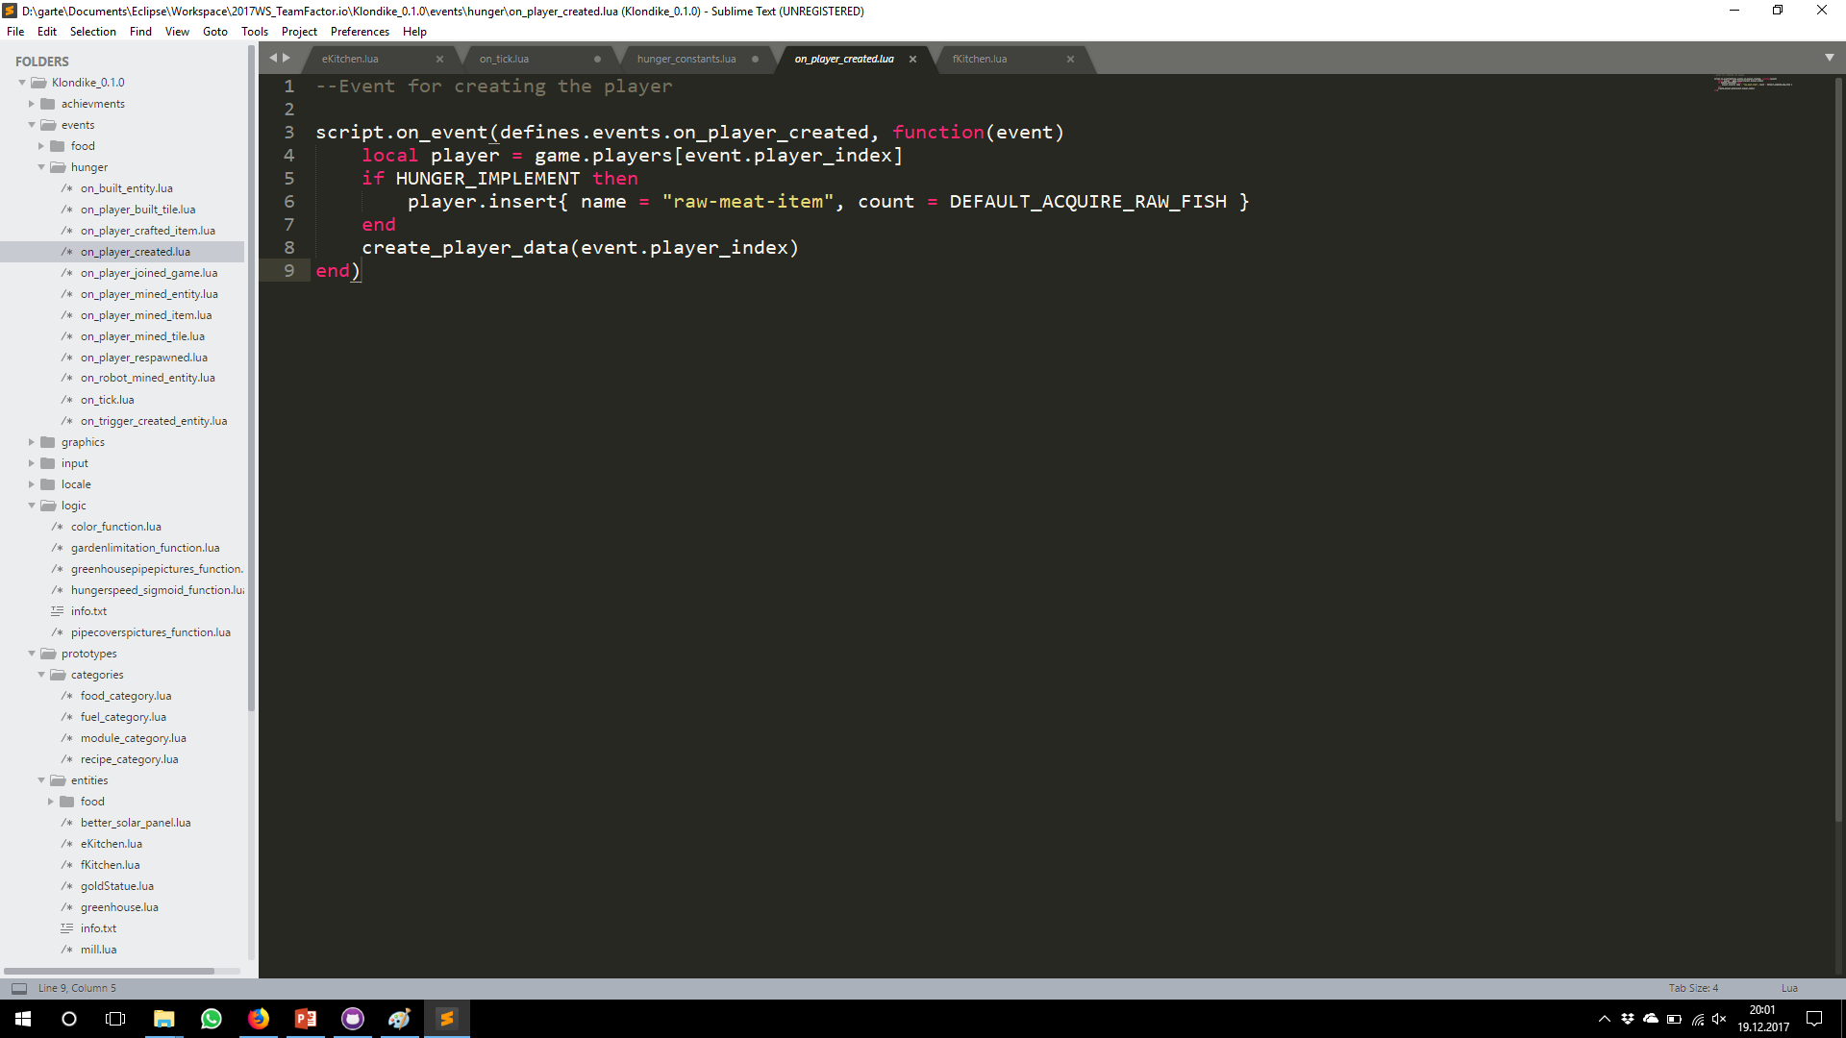

Slide 15


What else do we want to implement?

Slide 16
Live-Demo

